Slide 1
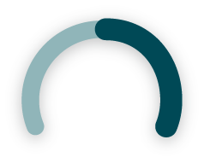
The labour shortage
68%
52%
84%
of Canadian businesses said they are having a hard time hiring people with the skill sets they need to grow.
KPMG's Business Outlook Poll
of small and medium Canadian businesses have had at least one open position for 4 months or longer.
Canadian Federation of Independent Business (CFIB)
of Canadian companies expect to face hiring challenges over the next year.
The Harris Poll, Express Employment Professionals
The hybrid workplace has expanded the talent pool making it more difficult to find talent.

Slide 2
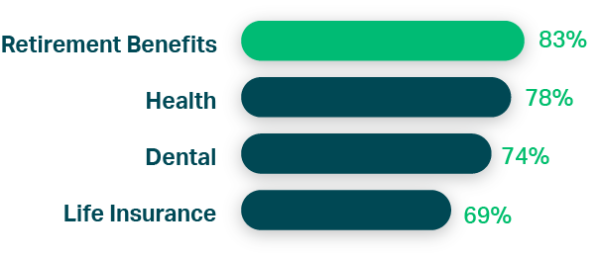
Workplace retirement plans rank as more important than health, life, and dental insurance for recruiting talent.
Recruit top talent with retirement benefits
#1 Talent Attraction Tool
Attracting and recruiting candidates is a top reason why many high-growth companies are introducing retirement plans.
Maru/Matchbox. HOOPP, “Canadian Employer Pension Survey” (October 2021)

Slide 3
Staff turnover is a growing problem
53%
66%
of employers are experiencing higher employee turnover since the pandemic.
McKinsey, ‘Great Attrition’ or ‘Great Attraction’? The choice is yours (Sept 2021)
of employers expect the problem to persist or get worse
McKinsey, ‘Great Attrition’ or ‘Great Attraction’? The choice is yours (Sept 2021)

Slide 4
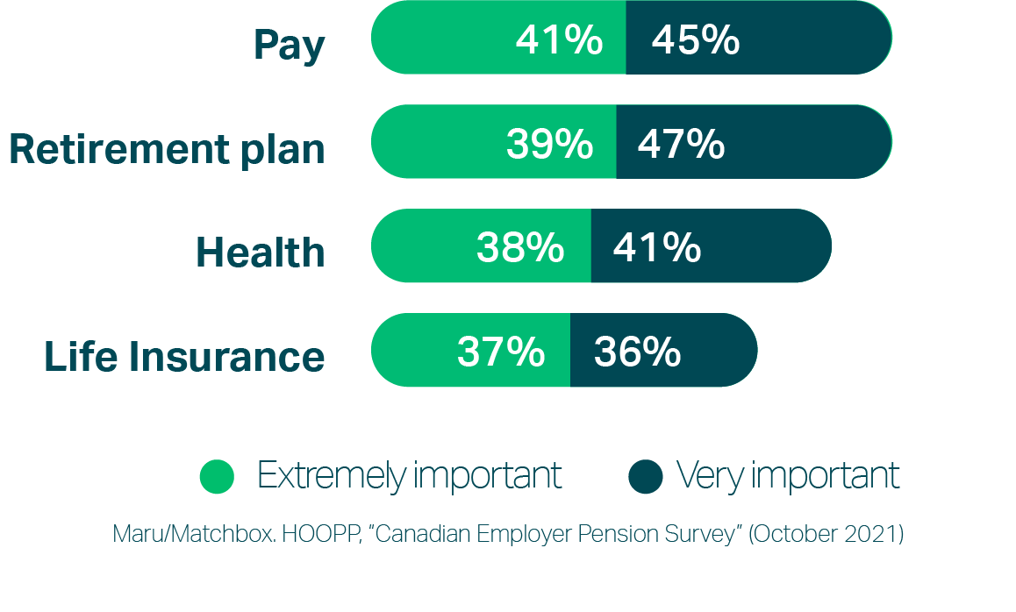
Keep employees happy with retirement benefits
#2 Talent Retention Tool
Retirement benefits help employers reduce turnover rates and can increase job tenure by up to 6 years.

Slide 5
75%
71%
78%
are concerned about having enough money in retirement.
Abacus Data, HOOPP, “National Survey on Canadians’ Preparedness for Retirement” (May 2021)
are willing to forgo a higher salary for a better retirement plan.
Abacus Data, HOOPP, “National Survey on Canadians’ Preparedness for Retirement” (May 2021)
view retirement benefits as a critical factor in deciding to take a job.
Accenture. “Pension benefits are critical factor for workers” (April 19, 2018)
Reward employees with benefits they want

Slide 6
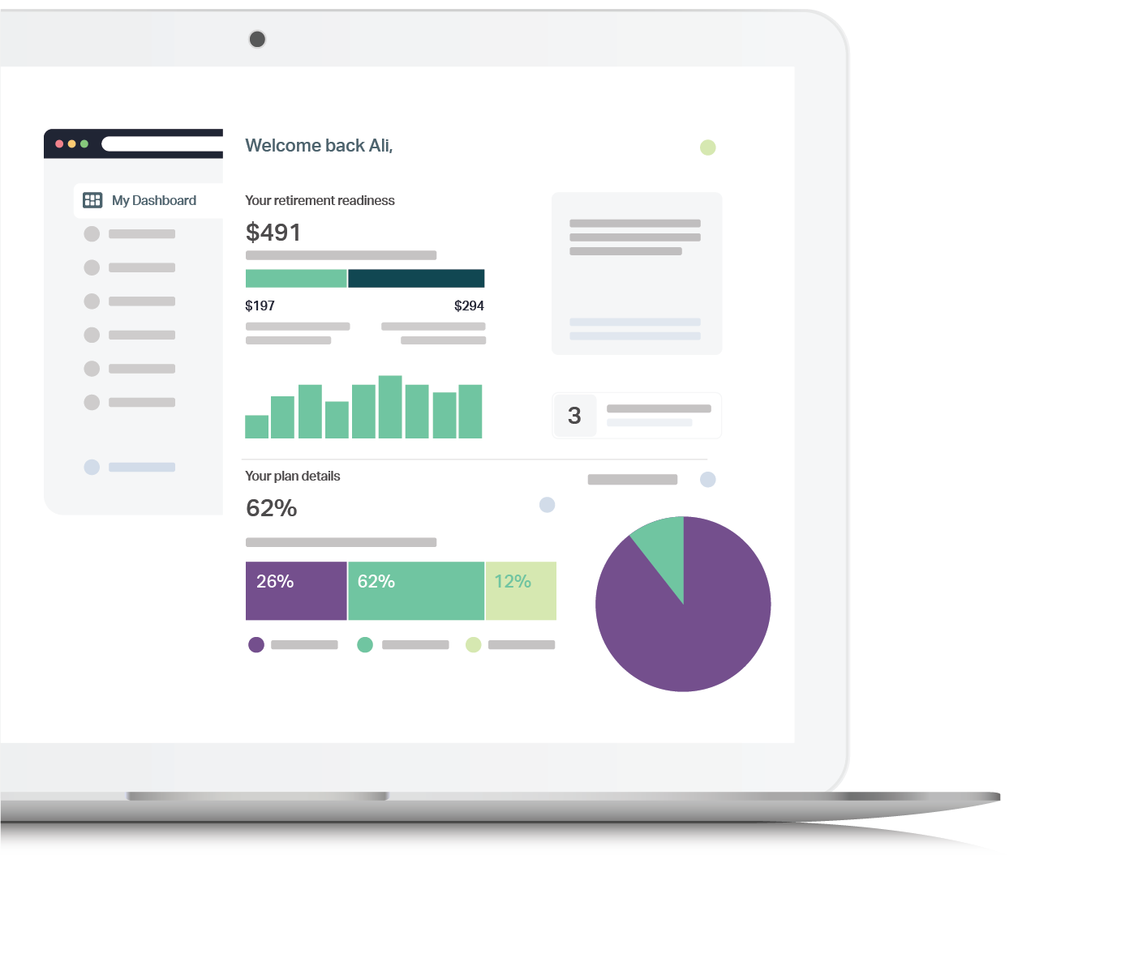
Save more.
Retire happy.
A low-fee plan your team will love
Helps employee savings go up to 2-3x further than a typical plan
AWARD-WINNING RETIREMENT PLATFORM
Easy setup & maintenance
Personalized planning
Find out how much you need to save for retirement.
Smart saving
RRSP & TFSA accounts to minimize taxes and maximize government benefits.
Low-fee automatic investing
Get matched to a professionally managed BlackRock® fund to grow your savings.
Consolidate investments
Transfer existing RRSPs/TFSAs to track personal, workplace and government retirement income in one place.
No investment knowledge required
Fully digital setup & enrollment
Flexible contributions & matching
Automatic payroll deductions
Employees keep their plan for life
Guaranteed income for life option
Ask for a demo

